Slide 1
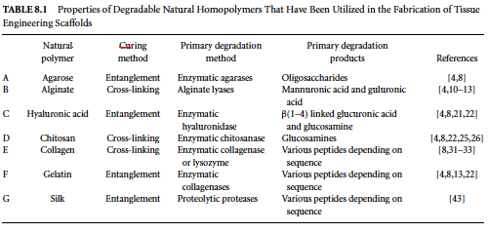
NATURAL POLYMERS For Scaffold Fabrication

Slide 2
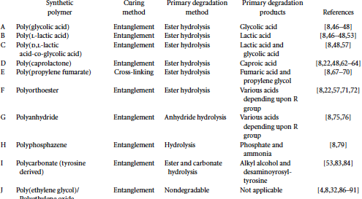
SYNTHETIC POLYMERS for Scaffold Fabrication

Slide 3
SCAFFOLD DESIGN PROPERTIES
Fabrication
Micro-Structure
Macro-Structure
Biocompatibility
Biodegradability
Mechanical Strength

Slide 4
Fabrication
Curing – Assembling polymer to form a bulk material for application.
Curing types
Polymer entanglement
Polymer crosslinking

Slide 5
Crosslinking
Involves the formation of covalent or ionic bonds.
Radical or an ion is required to form crosslinked polymers.
Adv. Is high mechanical strength.
It can be injected into tissue and cured in-situ.
Disadv. – cytotoxic
Due to byproducts.

Slide 6
Entanglement
Intertwining long, linear polymer chain to form loosely bound polymer network.
Advantage is its simple
Can be formed by heat, pressure or both.
Disadvantage is lacks mechanical strength.

Slide 7
Microstructure
Most cells are anchorage dependent – scaffold should aid cell growth.
Large surface area is required.
It should be porous to allow cells to infiltrate void areas.
Scaffold should possess a large surface area to volume ratio.

Slide 8
Macrostructure
Shapes of scaffold. ie. Fiber meshes, hydrogels and foams.
Fiber meshes – weaving or knitting (large surface area).
Fiber mesh mimics natural ECM.
Disadv. – lacks structural stability.
Hydrogels can absord high volume of water and allows cells to be encapsulated.

Slide 9
Hydrogels can be injected or molded into the tissue therefore used in minimal invasive manner.
Foam and sponge scaffolds provide a macro structural template for 3d tissue culture.
Methods for production include phase separation, emulsion freeze drying, gas foaming and solvent casting/particulate leaching.

Slide 10
Biocompatibility
Inflammatory response.
Its should limited and not prolonged.
Three phase tissue response
I. acute and chronic inflammation. (1-2 wks)
II. Granulation of tissue, a foreign body reaction and fibrosis.
III. Bulk of scaffold is lost by degradation.

Slide 11
Mechanical Strength
Mechanical strength is important for weight bearing orthopedic tissues.
Mechanical properties of the polymeric scaffold should be retained until the regenerated tissue can assume its structural role.
In general hydrophobic polymers have better mechanical strength than hydropholic polymers.

Slide 12
Biodegradability
Degradation products should be removed safely.
Design a scaffold`s degradation rate so that it is quicker than the rate of degradation proucts removal.
To minimize negative host response.
Surface degradation
Bulk degradation.

